Slide 1


DATA ANALYTICS SOCIAL BUZZ

Slide 2


Today's agenda
Project recap
Problem
The Analytics team
Process
Insights
Summary

Slide 3

Due to the rapid growth and digital nature of Social Buzz’s core product, the amount of data that they create, collect and must analyze is huge. Accenture has taken the 3-month project focusing on the following:
An audit of their big data practice.
Recommendations for a successful IPO .
An analysis of their content categories that highlights the top 5 categories with the largest aggregate popularity
Project Recap

Slide 4

Problem
Analysis to find the TOP 5 CATEGORIES with largest popularity .
Over 100,000 pieces of content is posted on the platform resulting in huge amounts of highly unstructured data.
Figuring the top 5 popular categories for a more targeted approach would help provide better business outcomes.

Slide 5



Vatsalya Daita
Data Analyst
The Analytics team
Michelle Grove
Data Scientist
Marcus Rompton
Senior Principal

Slide 6
Process
1
Understanding the Data Model
2
Data Cleaning
3
Data Modeling
4
Data Visualization
5
Drawing Insights

Slide 7

Insights
16
Unique Categories
Animals
Most Popular Category
68624
Aggregate Score of Animals

Slide 8
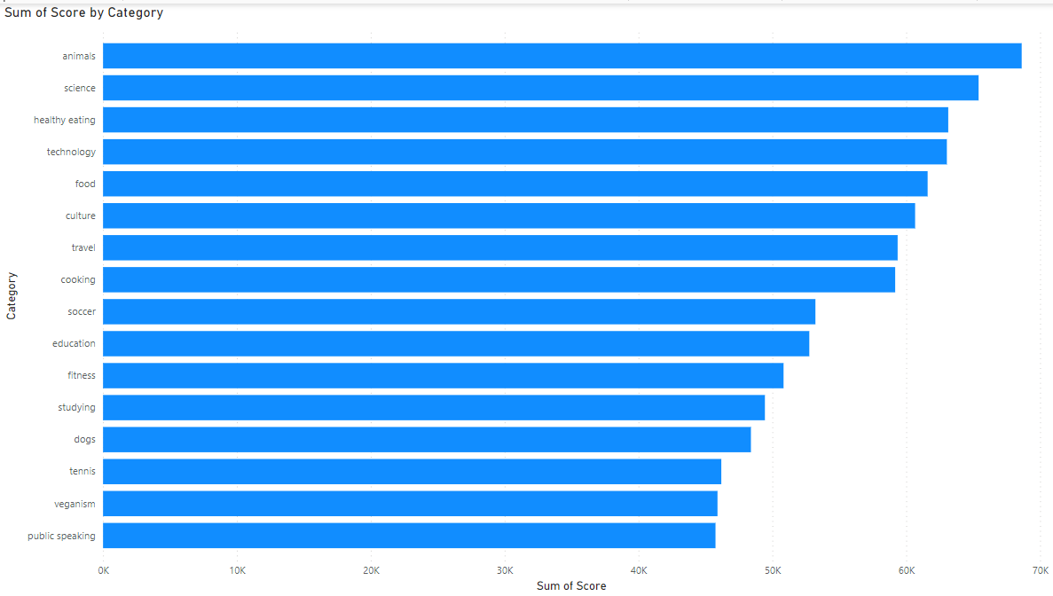

Slide 9
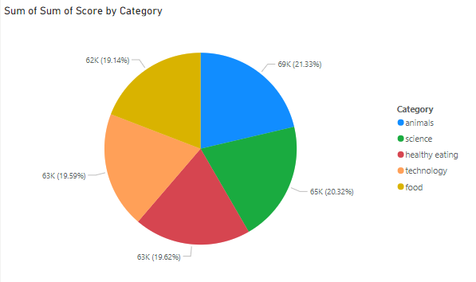

Slide 10

﻿At 68624, animals had the highest Sum of Score and was 49.99% higher than public speaking, which had the lowest Sum of Score at 45751.﻿﻿ ﻿﻿ ﻿﻿
Animals accounted for 7.68% of Sum of Score.﻿﻿ ﻿﻿ ﻿﻿
Across all 16 Category, Sum of Score ranged from 45751 to 68624.﻿﻿ ﻿
Animals accounted for 21.33% of Sum of Sum of Score.
Summary

Slide 11
Thank you!
ANY QUESTIONS?

